Slide 1
Diffie-Hellman Key Exchange and XOR Encryption/Decryption
Instructor: Lunshan (Shaun) Gao Ph.D. P.Eng
Group Members: Harshit Kawatra, Ismail Mukadam, Mohammed Sohail Ahmed

Slide 2
Introduction
The purpose of the project is to implement key exchange using the Diffie-Hellman algorithm and encryption/decryption with the XOR operation. The objectives are to understand modern cryptographic algorithms, enhance problem-solving skills in cryptographic code, and demonstrate encrypted message exchange between server and client. The scope includes implementing the Diffie-Hellman algorithm, using XOR for message protection, testing and validating the implementation, and improving the code for readability and security.

Slide 3
Theoretical Background
The Diffie-Hellman key exchange, developed by Diffie and Hellman in 1976, allows secure key exchange over an insecure channel. XOR encryption/decryption is a simple and fundamental encryption operation with reversible and symmetrical properties. The mathematical foundation of Diffie-Hellman relies on the difficulty of solving the discrete logarithm problem. The steps involved include selecting parameters (a prime number p and a generator g), generating private keys (a and b), exchanging public keys (A and B), and computing the shared secret. The security of this method is based on computational difficulty, though it is vulnerable to man-in-the-middle attacks.

Slide 4
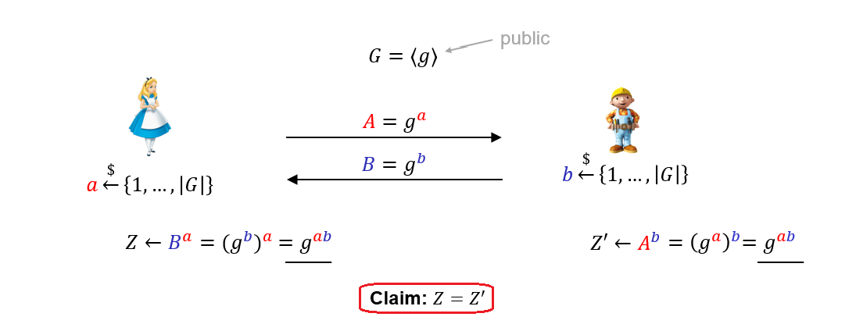
Diffie-Hellman Key Exchange Diagram

Slide 5
XOR Encryption/Decryption
XOR encryption/decryption is characterized by its properties of reversibility and symmetry. The process involves encrypting plaintext by XORing it with a key and decrypting ciphertext by XORing it with the same key. While simple and efficient, it is insecure if the key is reused, and is often combined with other techniques to enhance security.

Slide 6
The Math Behind Diffie-Hellman Key Exchange
The mechanics of Diffie-Hellman involve selecting a large prime number p and a base g, then each party generates a private key and a public key. The public keys are exchanged and used, along with the private keys, to generate a shared secret. This shared secret can then be used to encrypt subsequent communications.
The mathematical foundation of Diffie-Hellman is based on the discrete logarithm problem, which is computationally difficult to solve. This ensures that even if an attacker intercepts the public keys, they cannot easily compute the shared secret without the private keys.

Slide 7
Advantages of Asymmetric Encryption
Asymmetric encryption was used in this project to address the key distribution problem inherent in symmetric encryption. It uses a pair of keys, one public and one private, to securely exchange information without the need to share a secret key beforehand. This method allows for secure communication over an insecure channel and simplifies key management, as each user only needs to manage their own private key and the public keys of their communication partners.

Slide 8
Advantages and Limitations of Diffie-Hellman Key Exchange
Advantages of Diffie-Hellman include its ability to securely exchange keys over an insecure channel and its foundation in well-studied mathematical problems. Limitations include its vulnerability to man-in-the-middle attacks and the requirement for additional steps to ensure authenticity and integrity of the exchanged keys.

Slide 9
Server and Client Program
Server Program
Client Program
The server program listens for client connections, performs the key exchange, and encrypts messages. Key components include socket creation and setup, key generation (private and public keys), the key exchange process, and message encryption and transmission. Enhancements include robust error handling, secure random number generation, and input validation.
The client program connects to the server, performs the key exchange, and decrypts received messages. Key components include socket connection setup, key generation (private and public keys), the key exchange process, and message reception and decryption. Enhancements include robust error handling, secure random number generation, and input validation

Slide 10
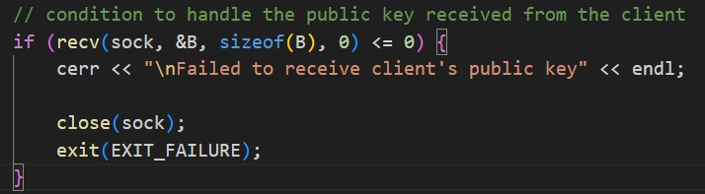
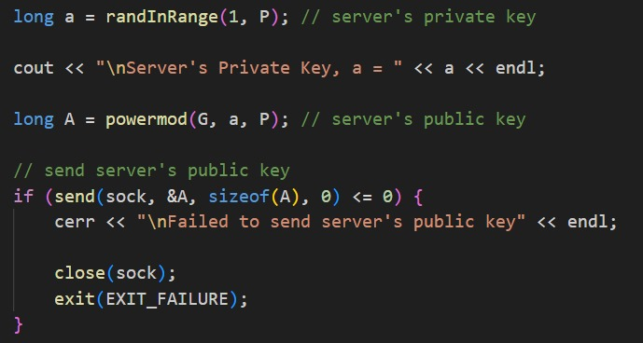
Implementation Overview
Img: Server receives client’s public key
Img: server's private key is created and shared its public key with client

Slide 11
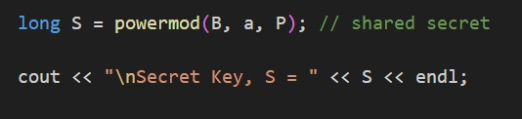
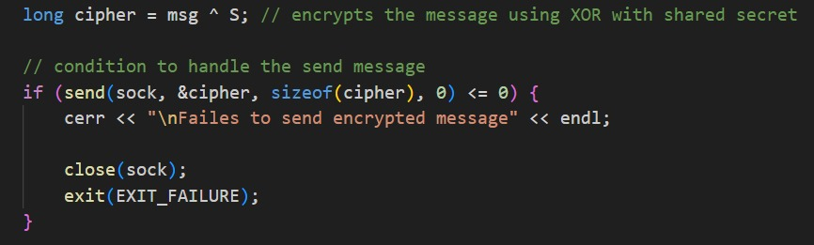
Img: Server calculates the shared secret
Img: server sends the encrypted message to the client

Slide 12
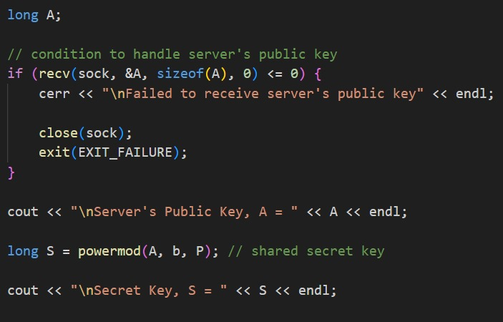
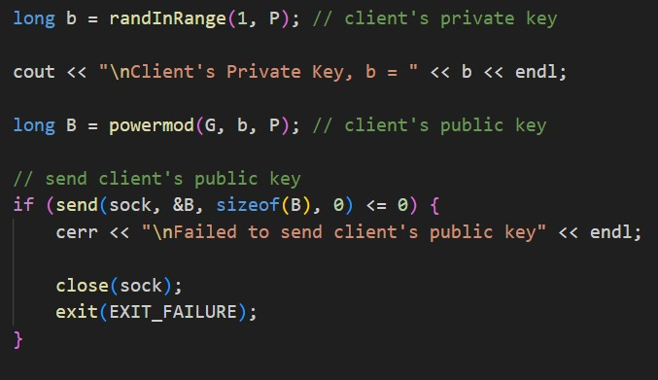
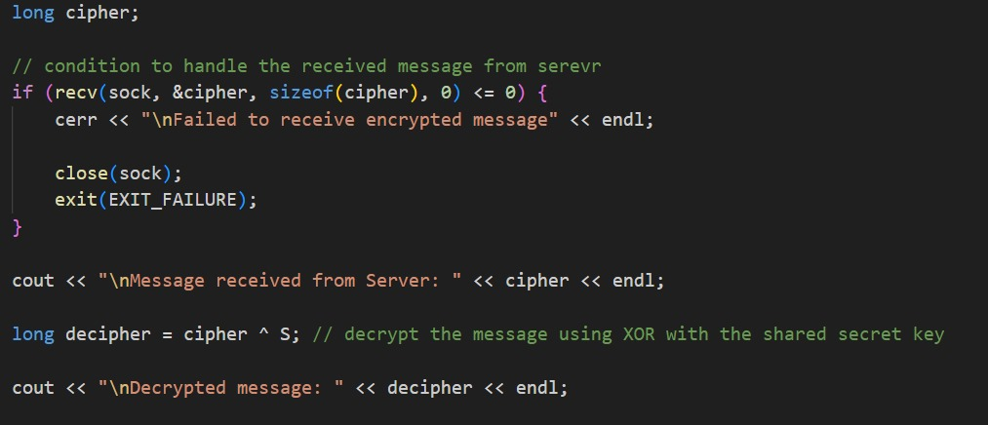
Img: client generates it's private key and shares it's public key with server
Img: client receives the server's public key and calculate the shared secret
Img: client received the secret message and decrypt the text

Slide 13
Testing
The testing phase included test cases for server and client port acceptance, validity of IP addresses, prime number validation for the 'P' variable, and non-number validation for the 'G' variable.

Slide 14
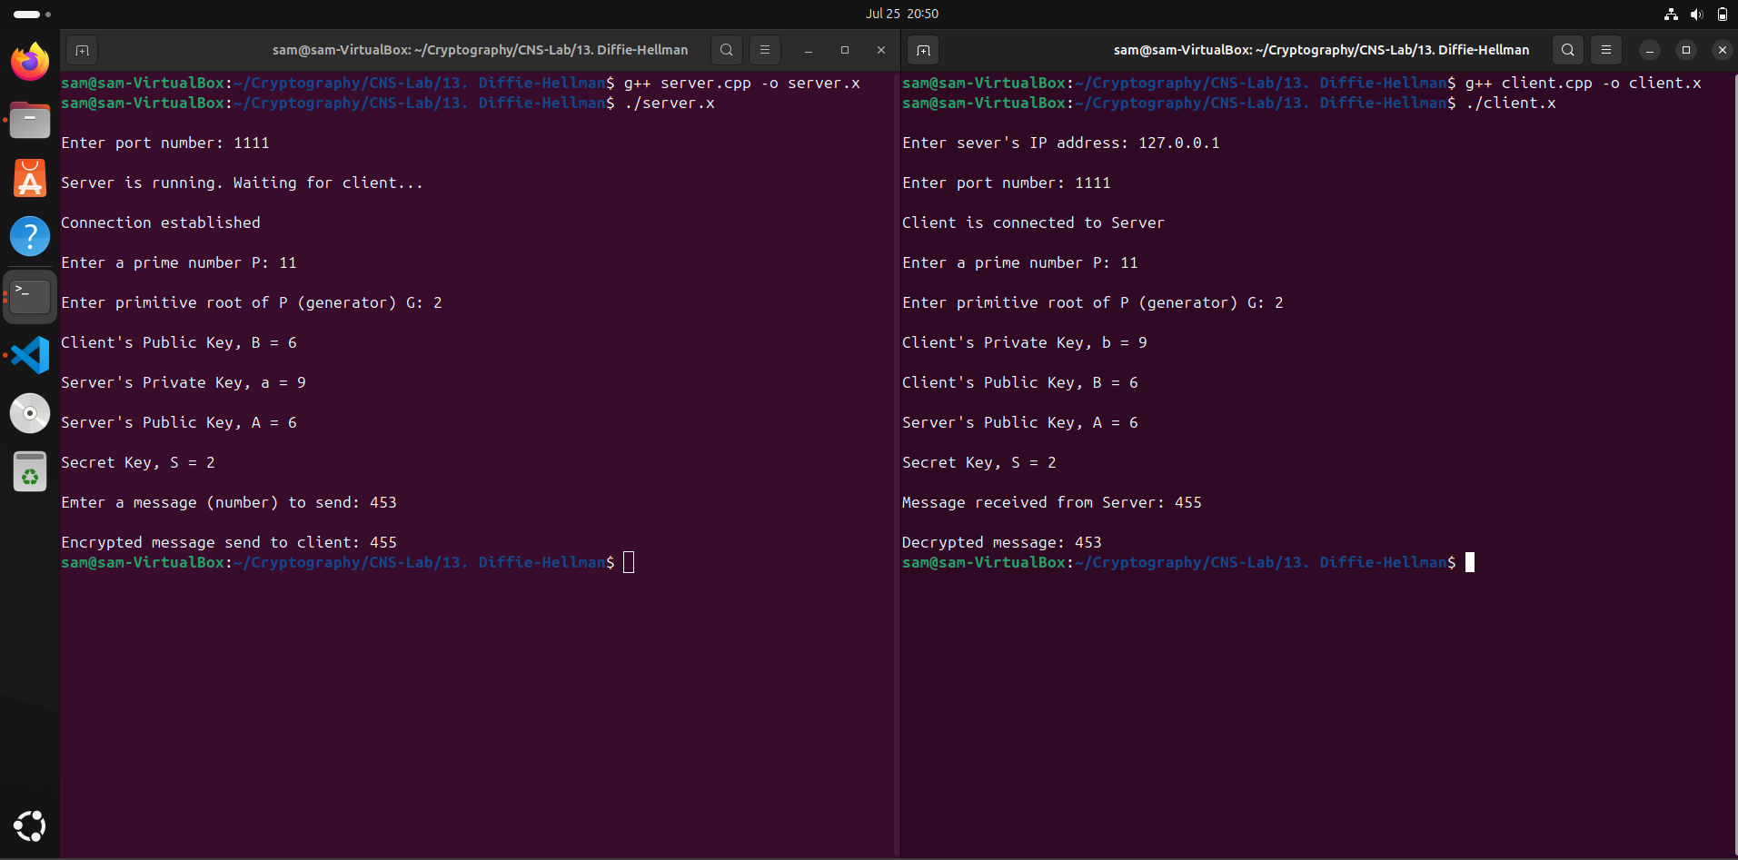
Test Case - I

Slide 15
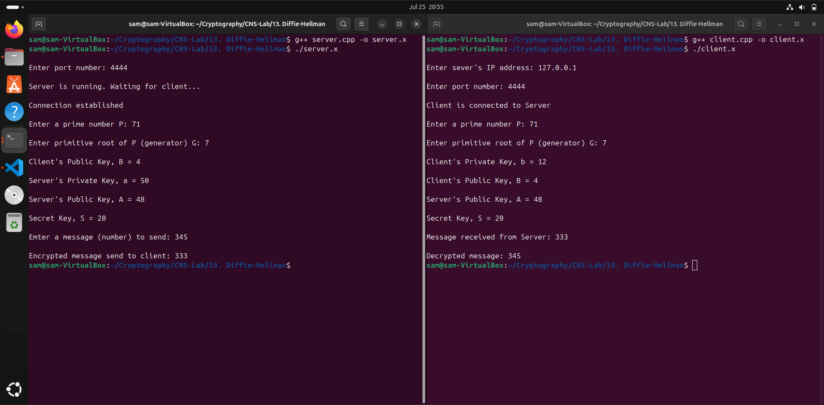
Test Case - II

Slide 16
Conclusion
In conclusion, the project successfully implemented the Diffie-Hellman key exchange and XOR encryption, demonstrating secure communication. Future work could involve enhancing security measures and improving user input validation.

